Slide 1
Solution
Design for Non-Relational Data

Slide 2




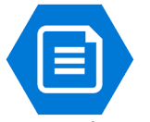
Primary Region
App Services
Storage
Internet
Blob Storage
Storage Account
Azure Files

Slide 3



Primary Region
VM
Storage
Internet
Blob Storage
Storage Account
Azure Files

Slide 4

Primary Region
App Services
Storage
Internet
Blob Storage
Storage Account
Azure Files
Secondary Region
App Services
Storage
Blob Storage
Storage Account
Azure Files

